Slide 1
Transmitter of Basic Monochrome Television System
Sadia Afrin Zerin
ID: 11809024

Slide 2
Concepts of Basic Two terms:
Television Transmitter-
Electronic device radiating radio waves that carry a video signal along with synchronized audio channel.
TV transmitters are licensed by the government.
TV Transmitter + Broadcast Studio = Television Station

Slide 3
Concepts of Basic two terms:
Monochrome Television-
Television in which the final reproduced product is monochrome is known as monochrome television(Analog).
Also known as black and white television.
The brightness, colors and sound are represented by the amplitude, phase and frequency.

Slide 4
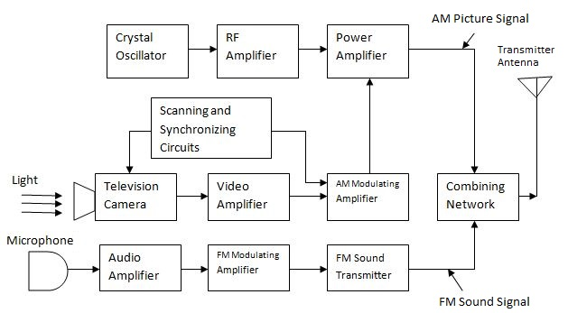
Block Diagram of the Transmitter of Monochrome Television System:

Slide 5
Parameters of Monochrome TV Transmitter:
It has a video information, in between black and white with the shade of grey.
It transmits on channel on VHF and UHF frequency.
Picture and sound signals are modulated on RF carrier to reduce antenna size.

Slide 6
Thank You

